Slide 1
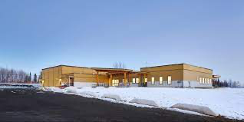

Babine Elementary Secondary School
Enhancing Student Learning Plan

Slide 2
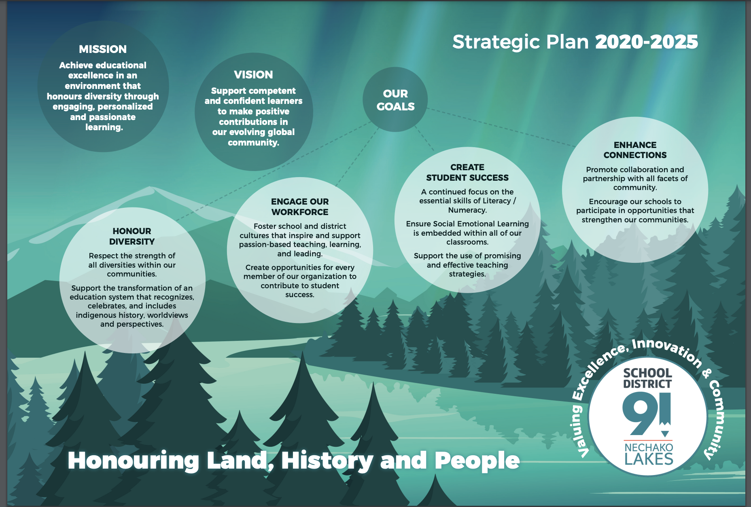
How does B.E.S.S. fit into the District's Strategic Plan?

Slide 3
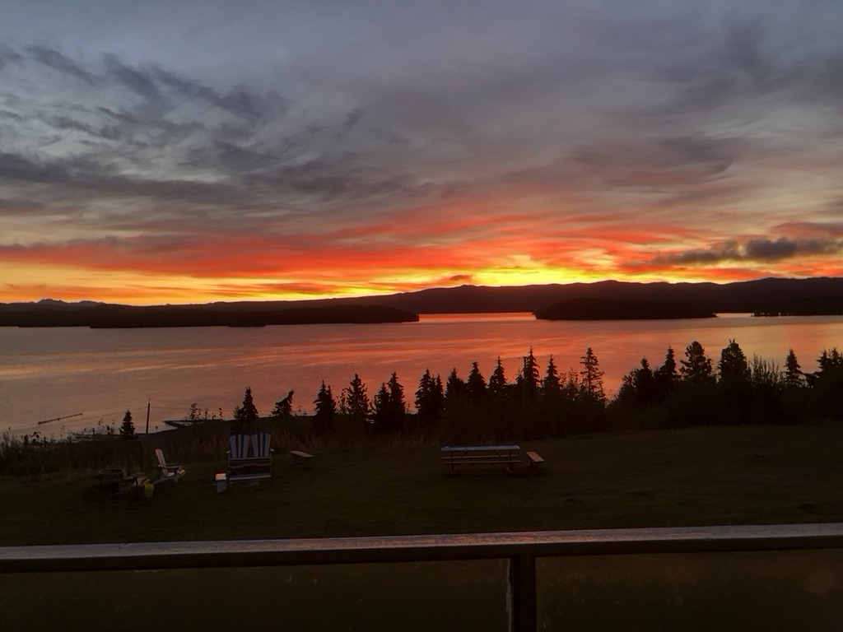
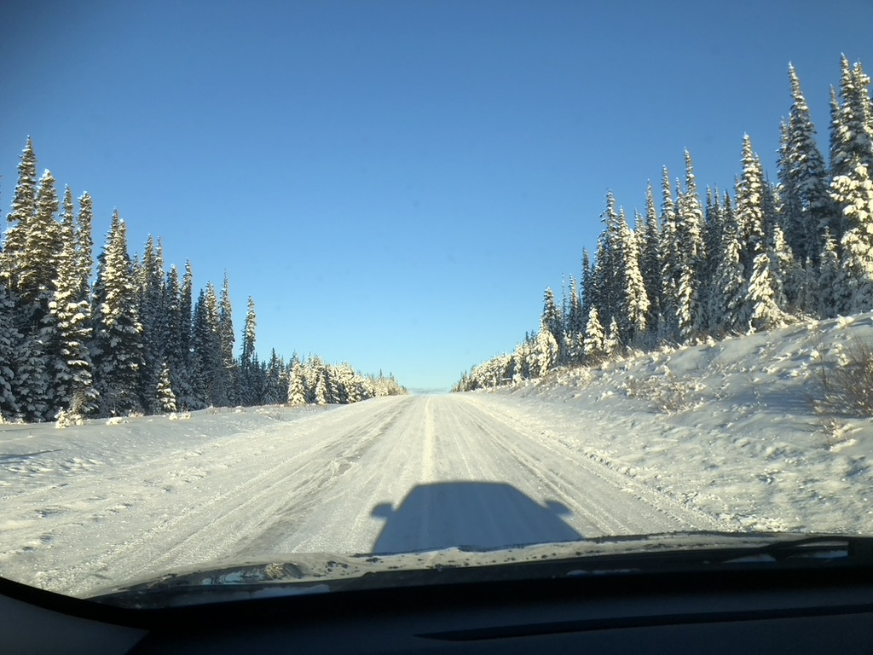

Where is our place of learning?

Slide 4
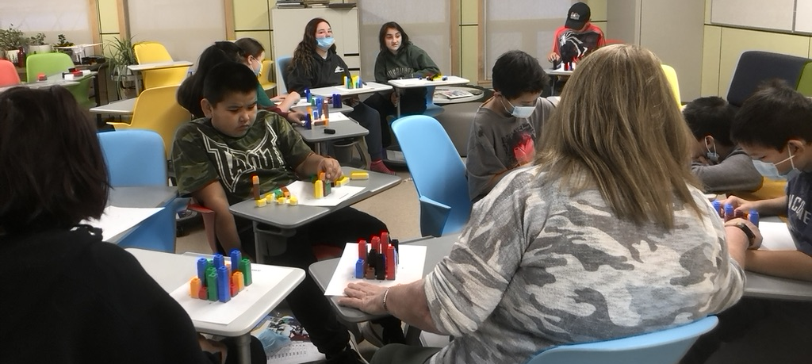
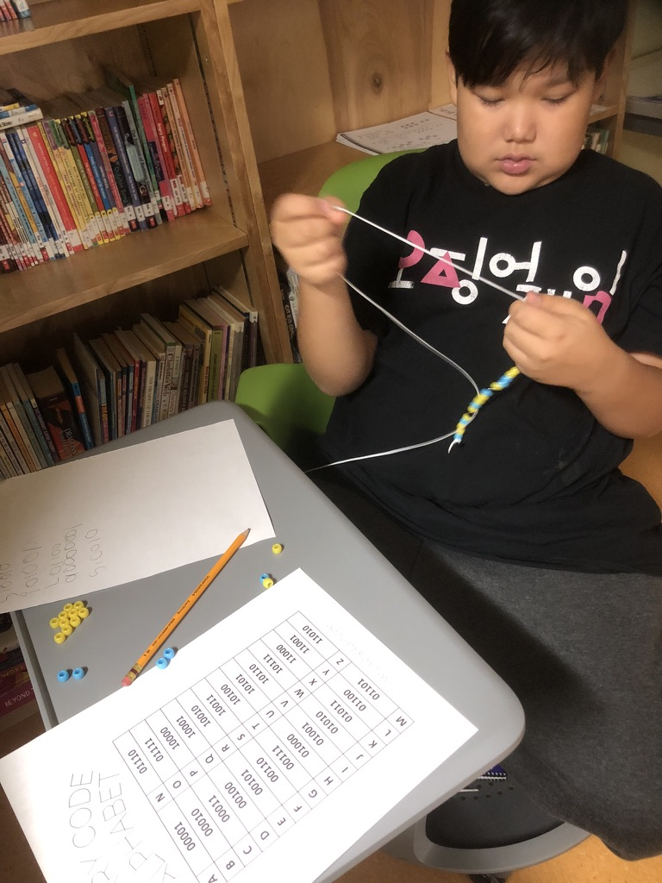
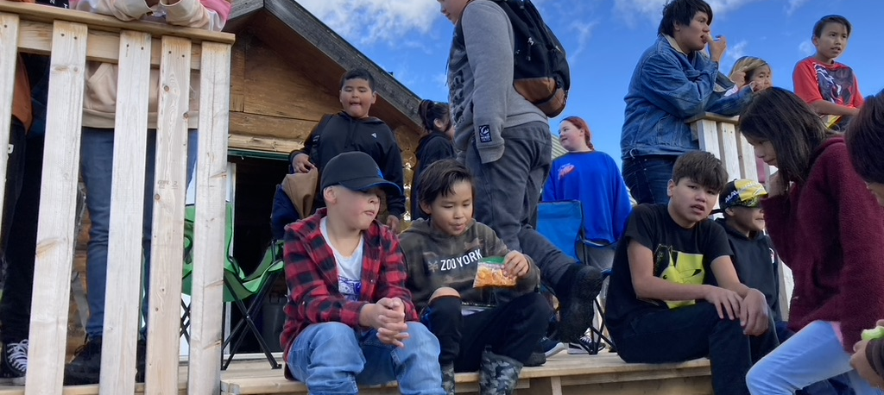
With the help of Mike, Leona and Mark, educators, staff, students and community members are working to re-invent our school's culture...shifting from surviving to thriving.

Slide 5
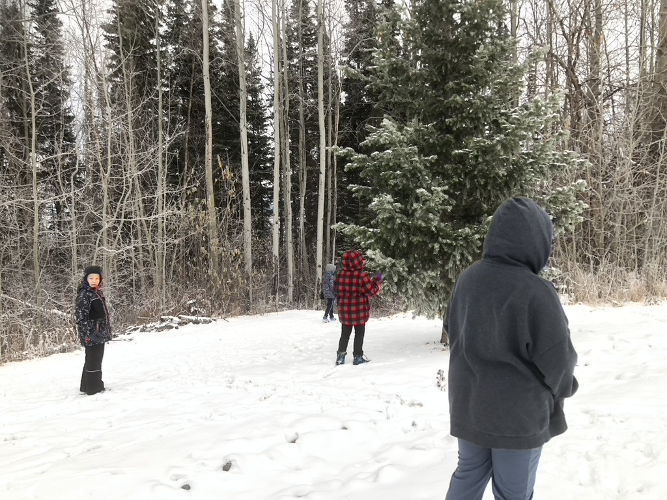
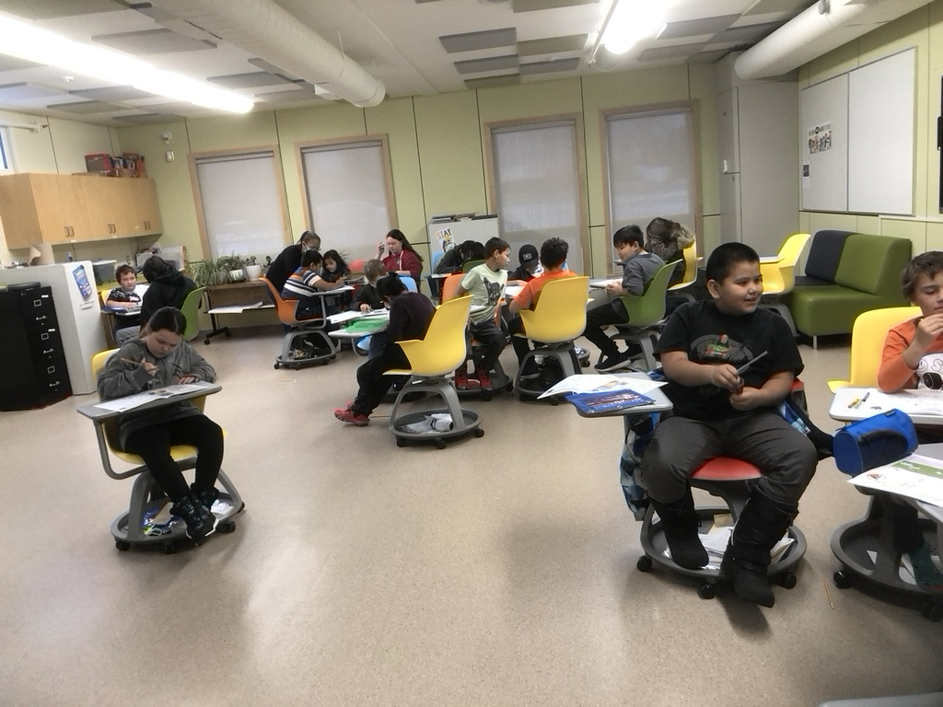
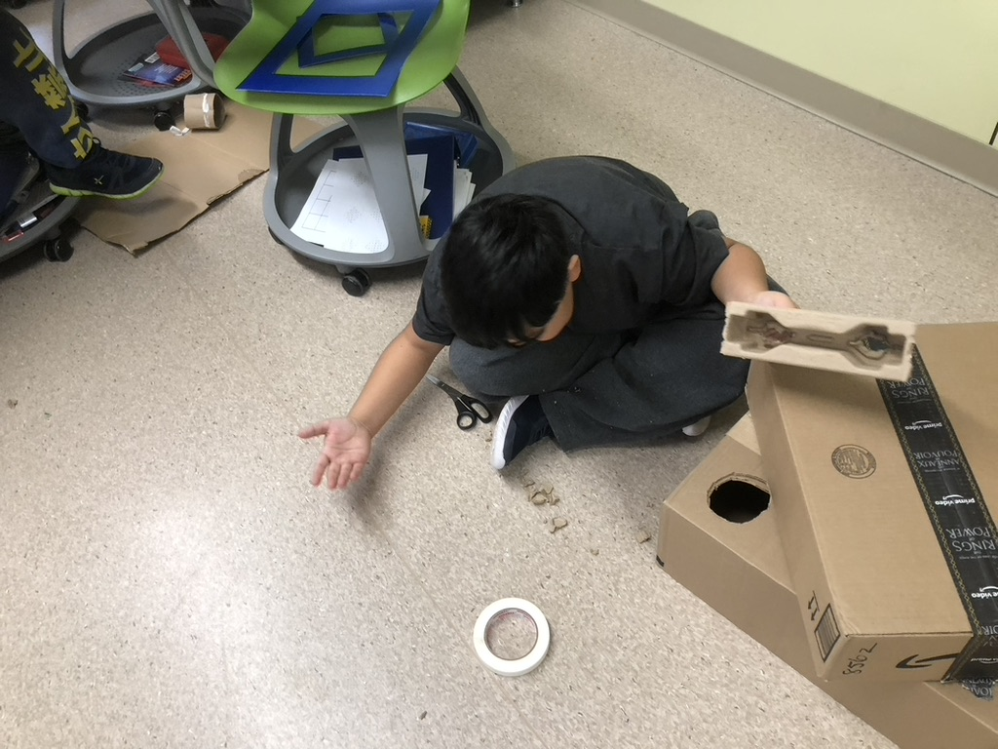
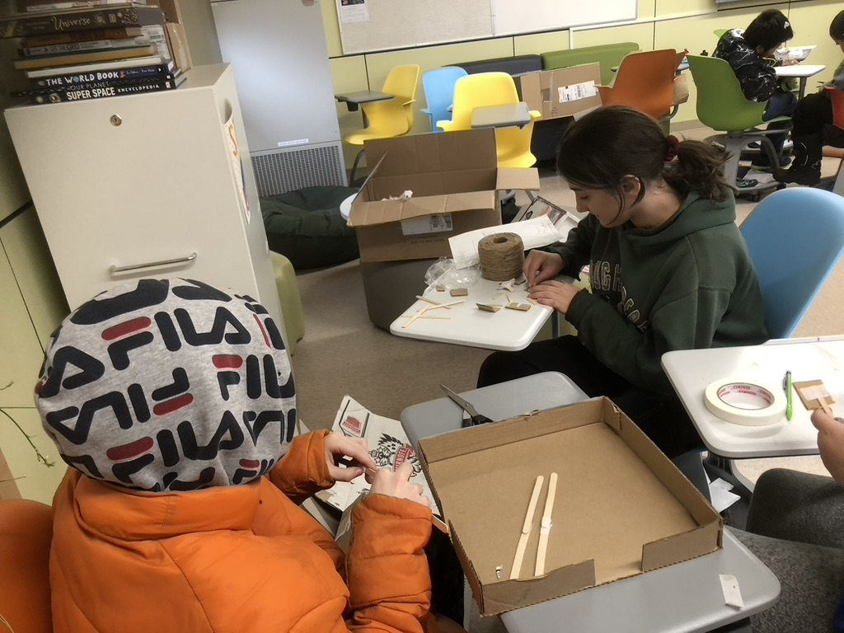
Current Data
We are performing below grade levels in every academic area for which data is gathered – especially numeracy and literacy. Indicators on assessments that students had relationships and a sense of belonging but little motivation to succeed or persevere with learning. We acknowledge that our primary goal was to develop a learning mindset...

Slide 6
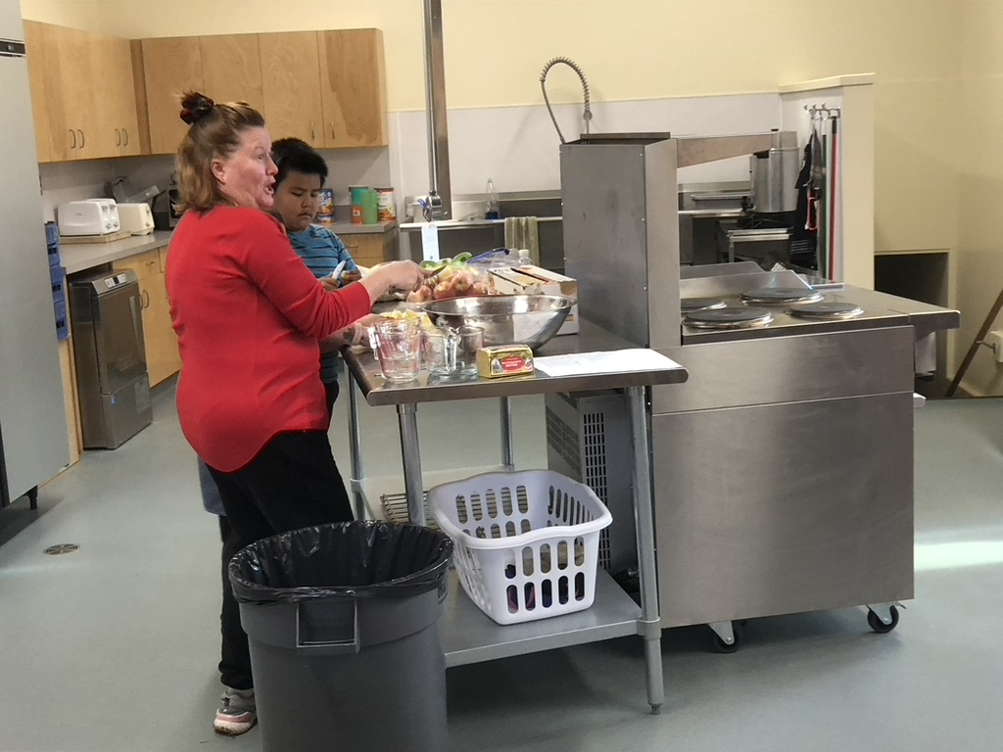
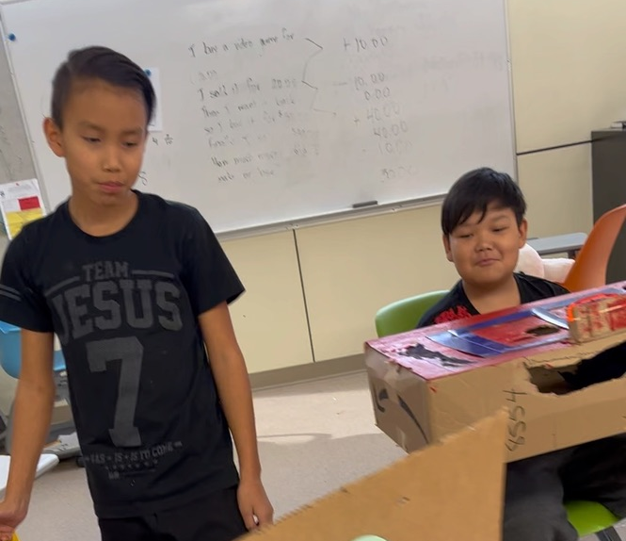
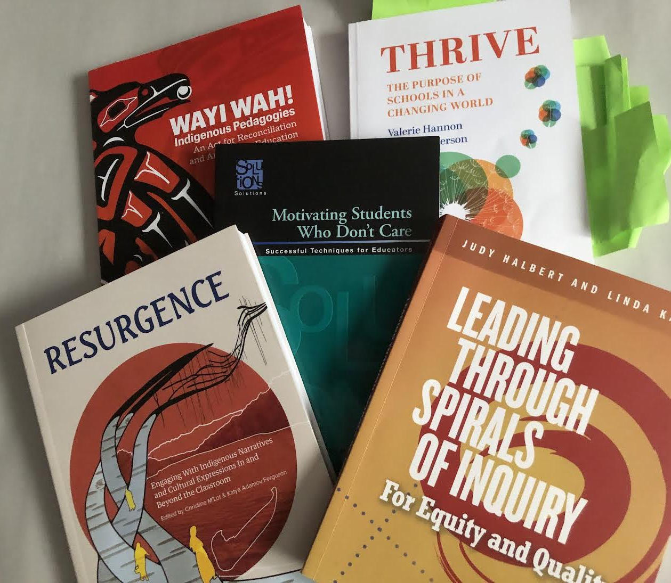
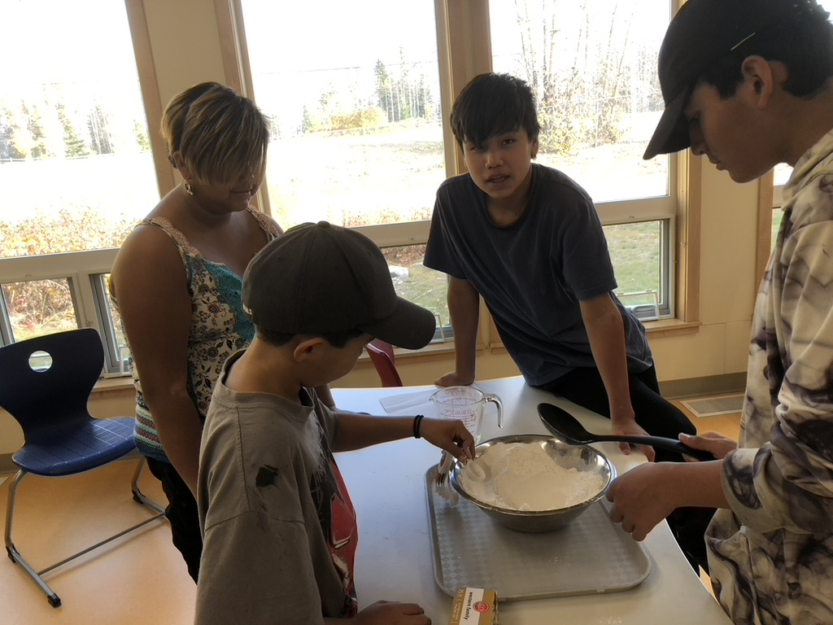
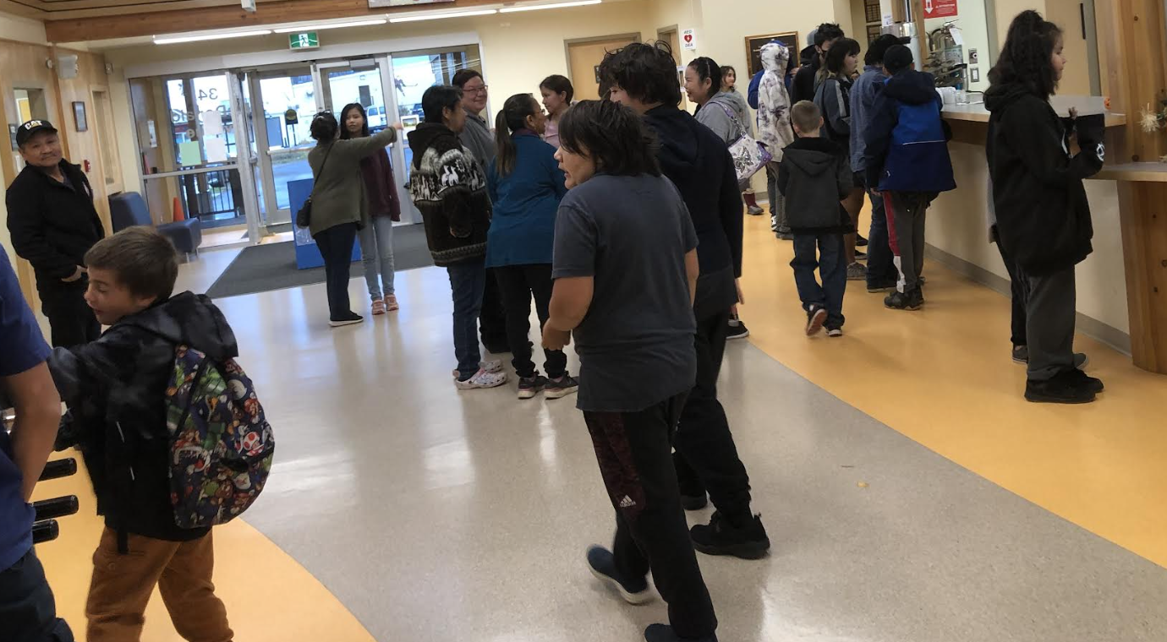
Creating Student Success...taking a research-based approach that included everyone's voices
What does success mean for each of us?

Slide 7
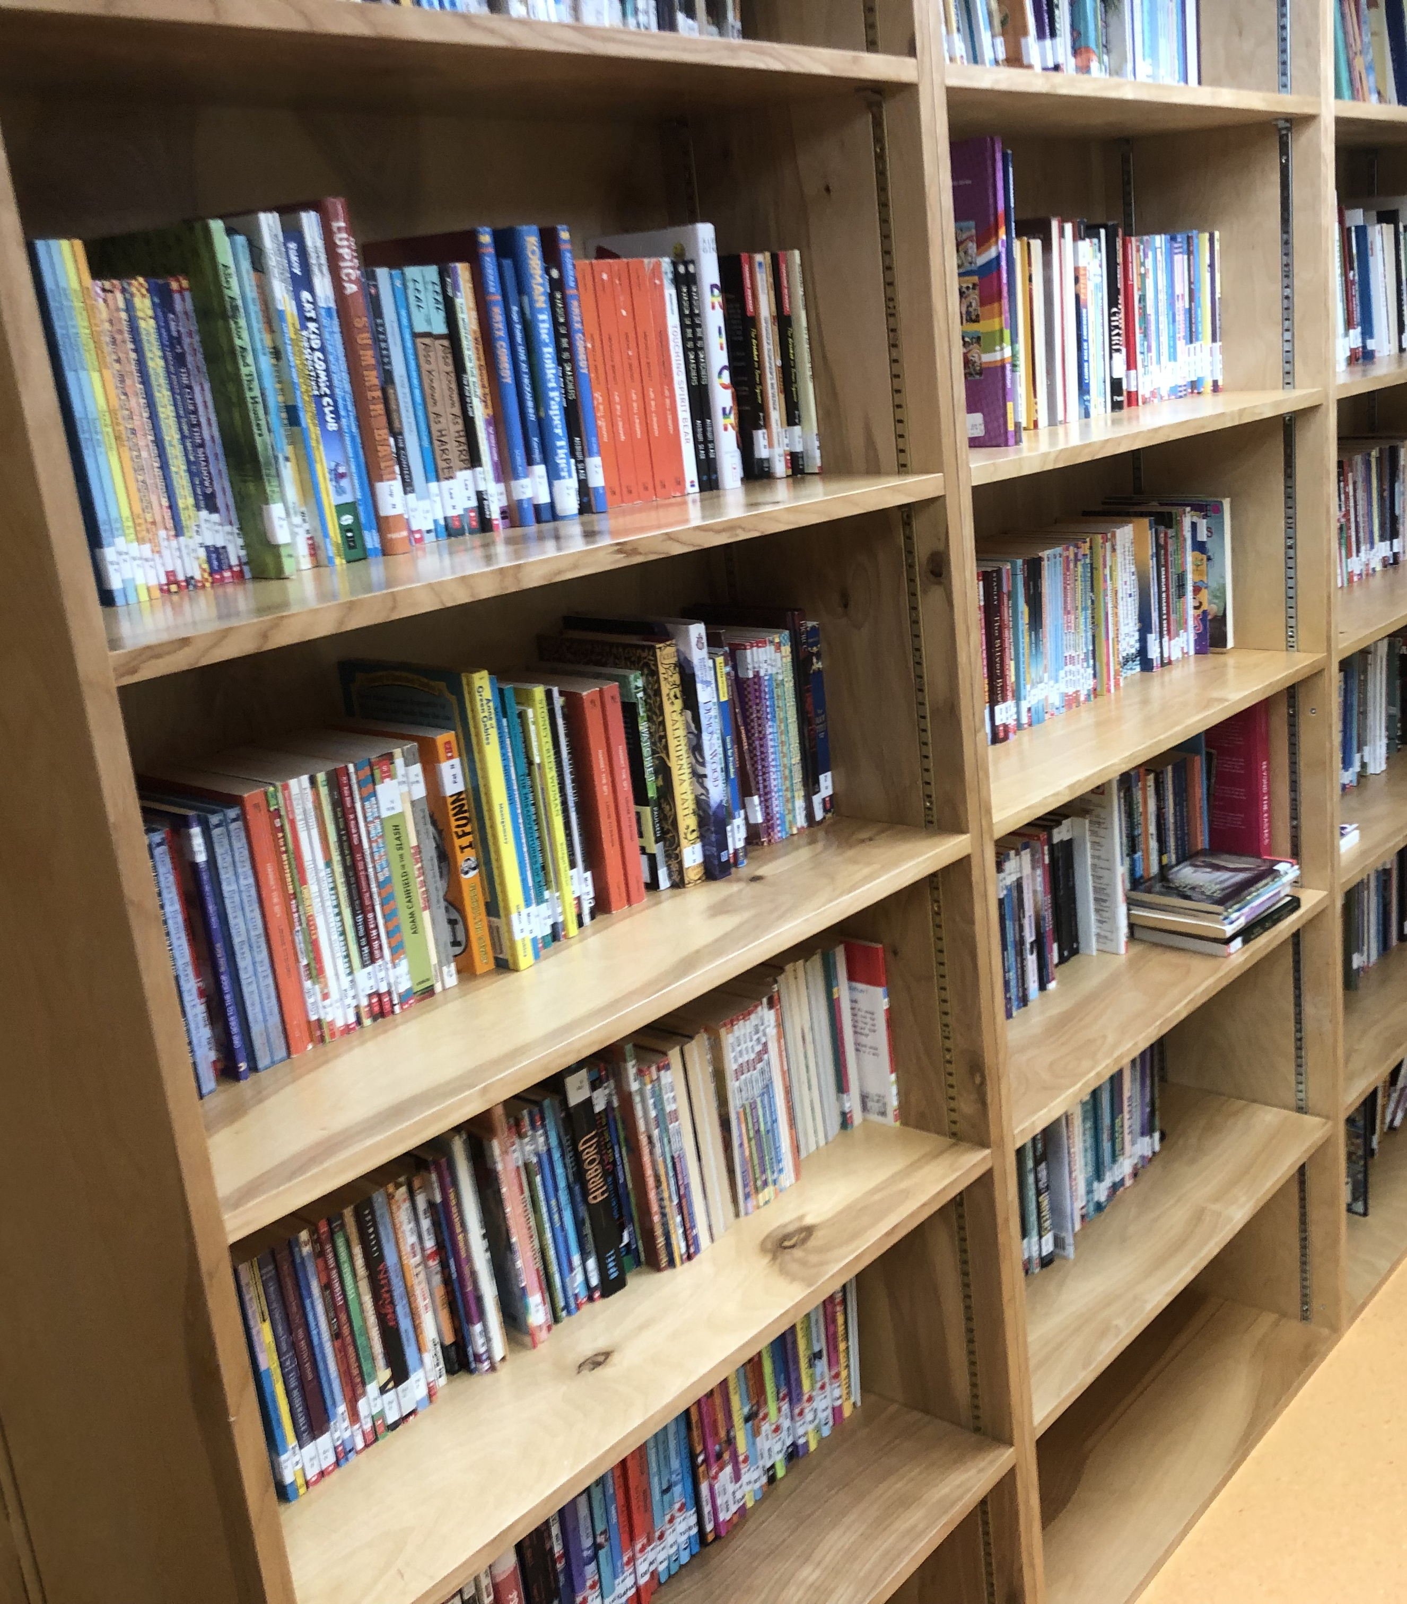
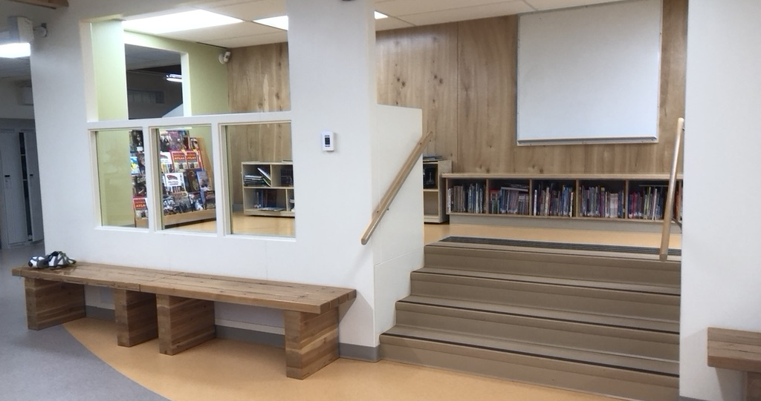
Literacy – students wanted a space to access books so we created a library
Books were stored in individual classrooms – we used our Love of Reading Grant money and gathered books from individual classrooms to create a library space.

Slide 8
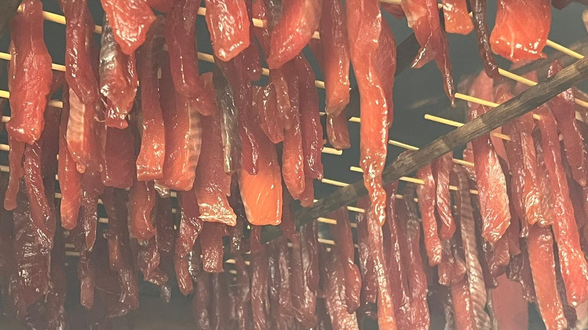
Numeracy – creating a focus on real life problems

Slide 9
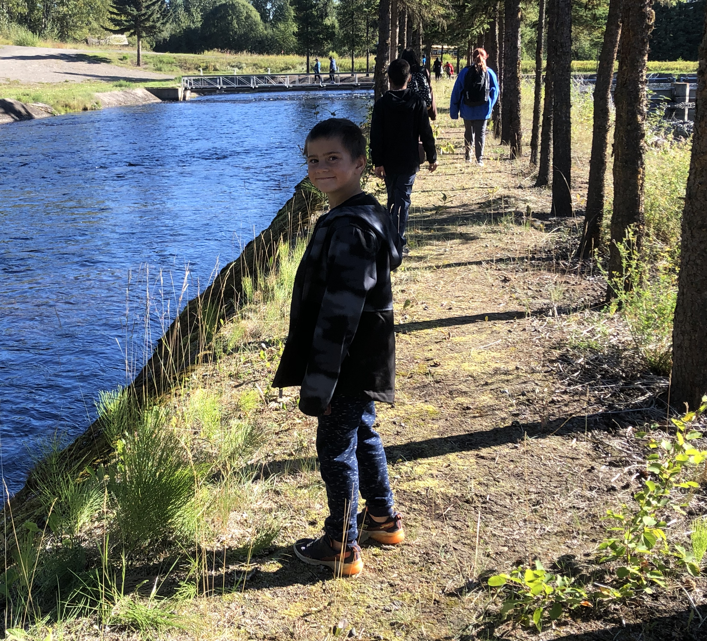
Social Emotional Learning – the heart of our work...
We believe that a 'whole education is one that allows students and adults to enter into learning with all aspects of self being realized.

Slide 10
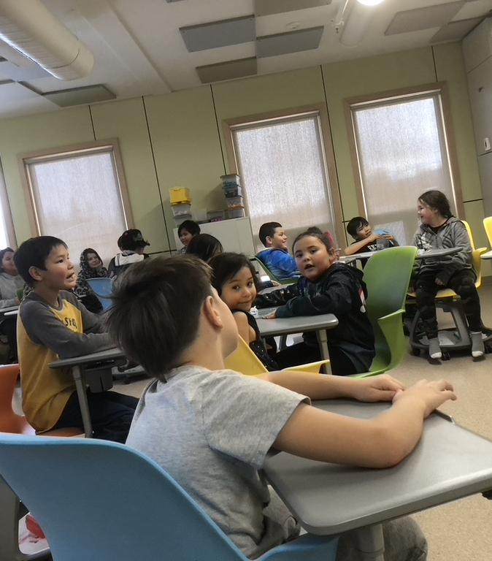
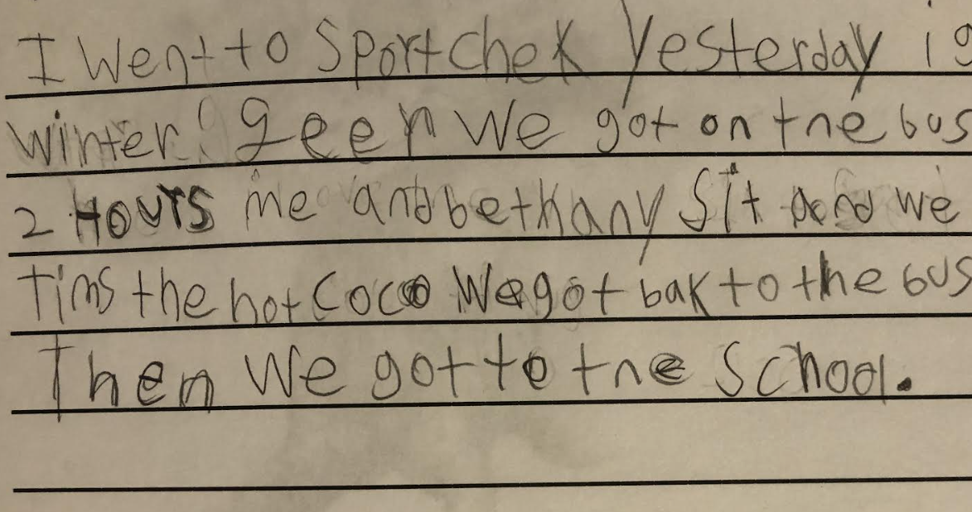
What does our data tell us?
Gr. 4 writing sample
-very few students are at grade level in any subject area
-an early in the year focus on social-emotional learning has developed relationships and an increasing interest in academic achievement
-parents are indicating a greater satisfaction with the school's direction and purpose

Slide 11
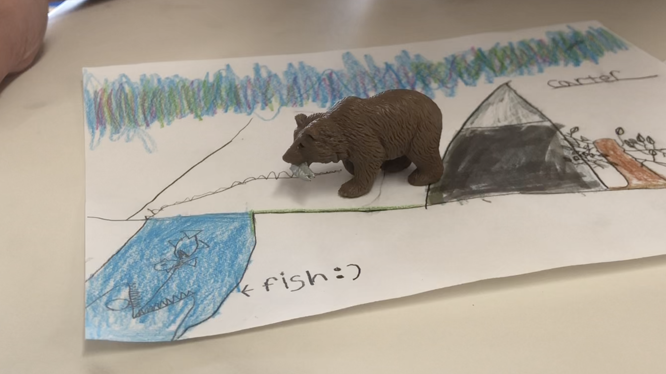
Honoring Diversity...in all its forms...
Using place, relationships, culture and language, identity and understandings of who we are and knowing that we have options for our futures

Slide 12
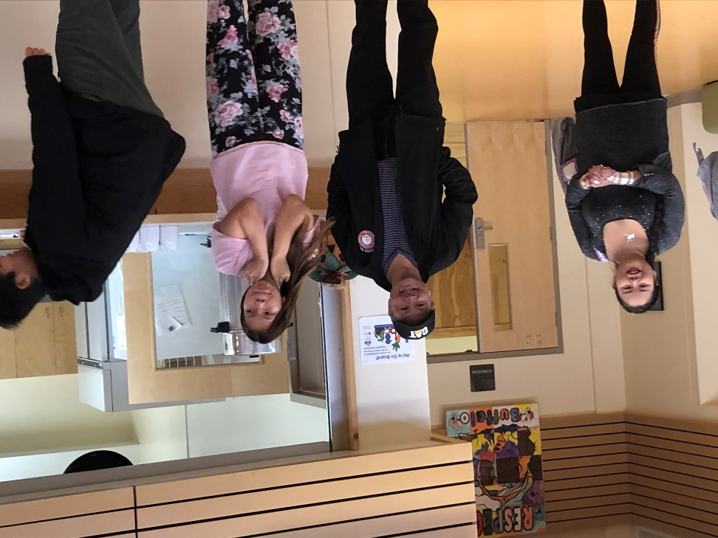
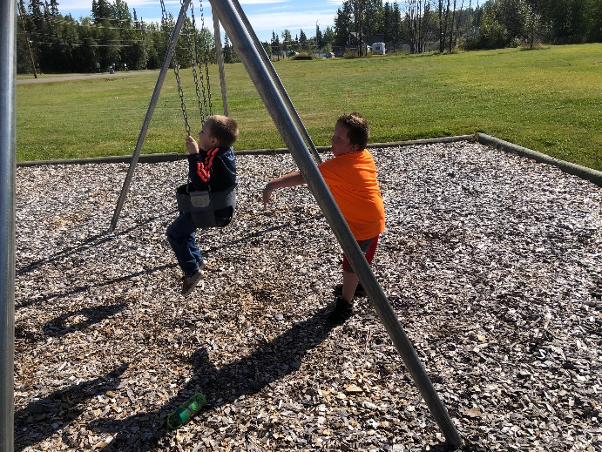
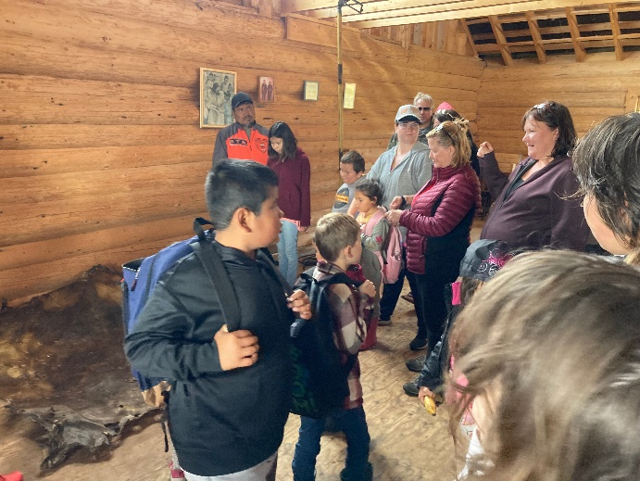
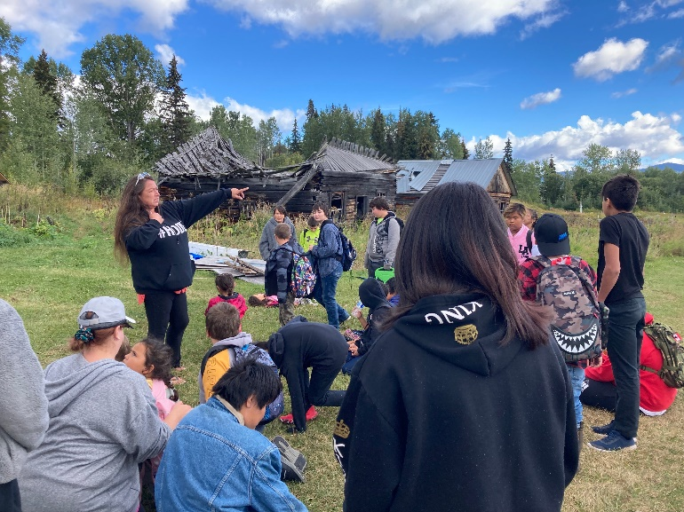
Enhancing Connections

Slide 13
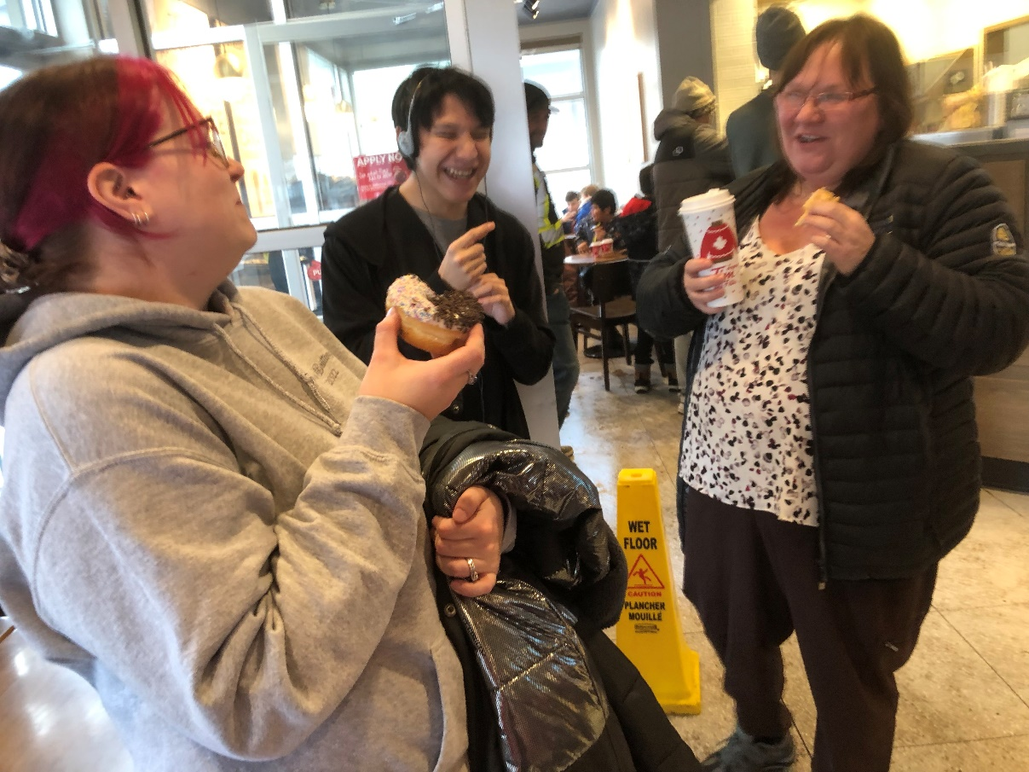
Engaging our Workforce

Slide 14
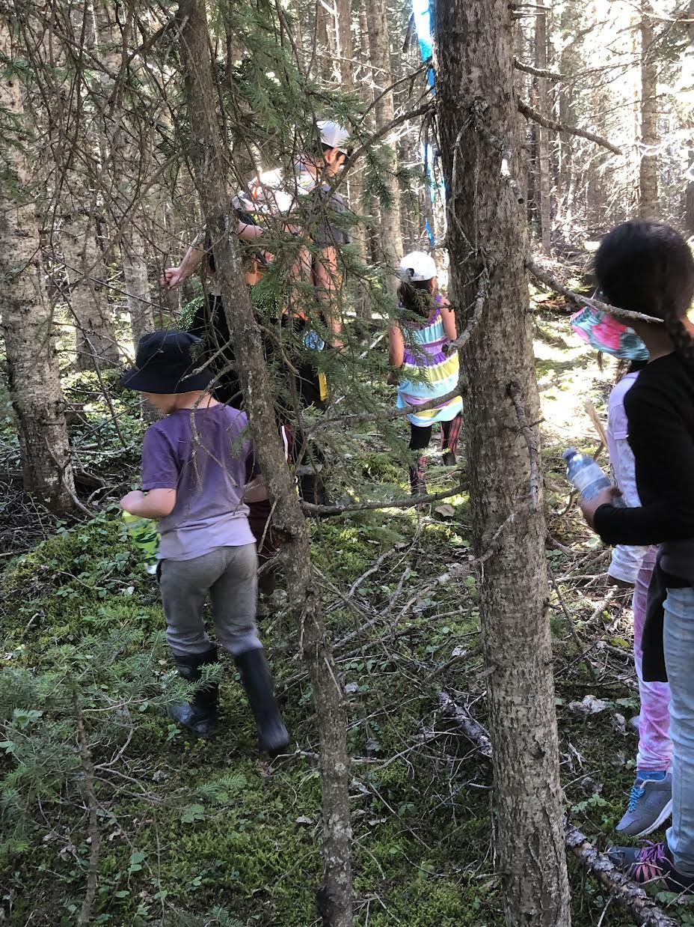
Where are we going?

